Slide 1
Introduction to Computational Flow Cytometry in R
Gabriel Rosenfeld, PhD
Data Scientist
Bioinformatics and Computational Biosciences Branch

Slide 2
Bioinformatics and Computational Biosciences Branch (BCBB)
My background: Data Scientist in the Bioinformatics and Computational Biosciences Branch in the Office of Cyber Infrastructure and Computational Biology
Check us out: https://bioinformatics.niaid.nih.gov/researchcollaborationandsupport
Do you conduct research involving genomics (clinical, meta and microbial), imaging, data science and biostatistics, or structural biology?
We offer collaboration opportunities to address research questions at no direct cost to the NIAID research community and collaborators
Email: bioinformatics@niaid.nih.gov

Slide 3
Course Objectives
The course will show how to use R to enhance your flow cytometry analysis using computational approaches
Learning Objectives:
Using R for computational flow cytometry
Learning flow cytometry data structures
Loading FCS files
Data pre-processing (QC, compensation, transformation)
Automated Gating
Visualization
Basic statistics

Slide 4
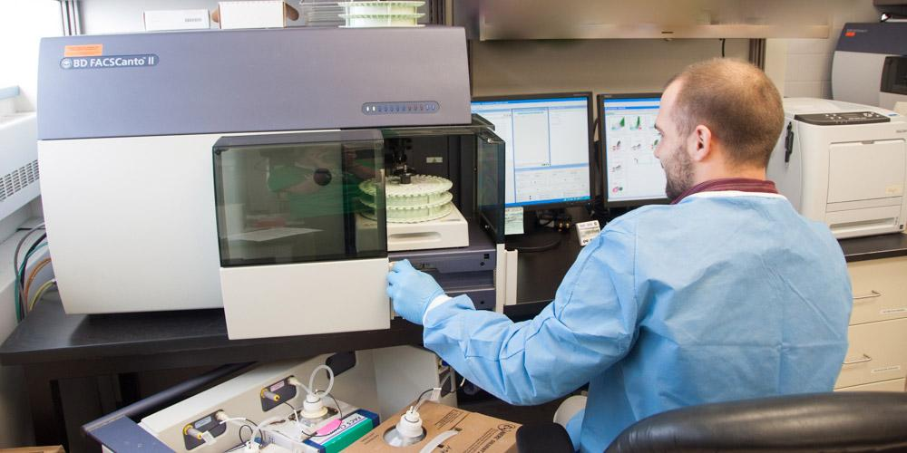
What is Flow Cytometry?
https://www.upstate.edu/pathology/healthcare/provider-info/flow_cytometry.php

Slide 5
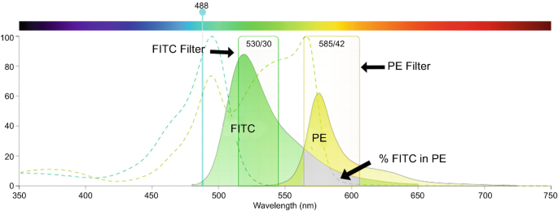
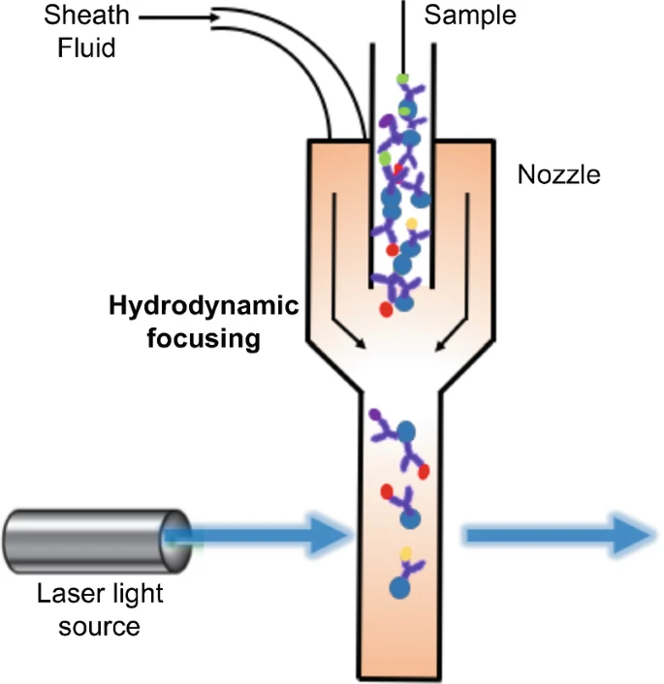
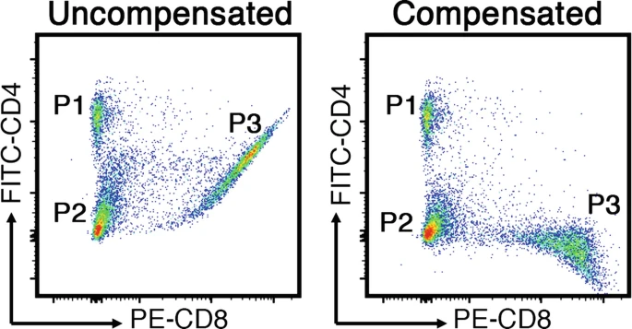
What is Flow Cytometry?
Schmit, T., Klomp, M. and Khan, M. (2020) "An Overview of Flow Cytometry: Its Principles and Applications in Allergic Disease Research", Methods in Molecular Biology, pp. 169-182. doi: 10.1007/978-1-0716-1001-5_13.

Slide 6
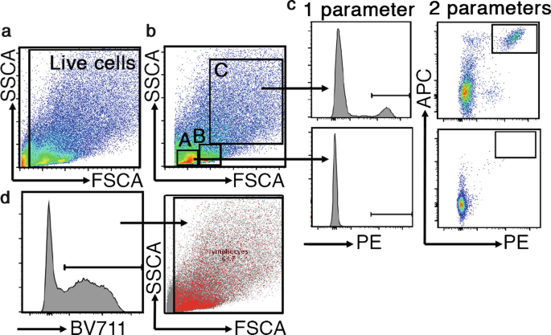
What is Flow Cytometry?
Schmit, T., Klomp, M. and Khan, M. (2020) "An Overview of Flow Cytometry: Its Principles and Applications in Allergic Disease Research", Methods in Molecular Biology, pp. 169-182. doi: 10.1007/978-1-0716-1001-5_13.

Slide 7
Best Practices for Flow Cytometry Data Analysis
Like any data coming from the lab: upstream factors can have a huge impact! (e.g., sample prep, flow cytometer performance/settings/calibration, etc.)
Identify any data issues through visualizations (single channel, or multi-channel using PCA, UMAP) and initial data exploration -> batch effects, poor quality staining or outlier samples, etc.
Ensure proper understanding of the experiment: are controls sufficient, what is the biological question?
Always run a QC-> manual check and gating out debris/noise/margin events or an automated data QC using an available algorithm
Be aware of common pitfalls during data analysis: 1) outlier samples, 2) using the right statistical method for the biological question, 3) keeping simple and avoiding over-interpretation and noise

Slide 8
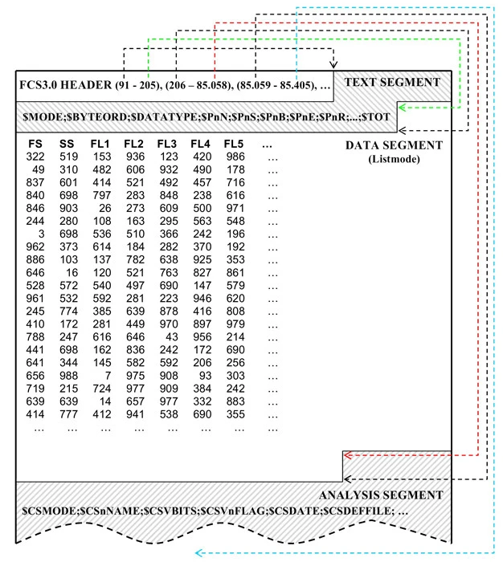
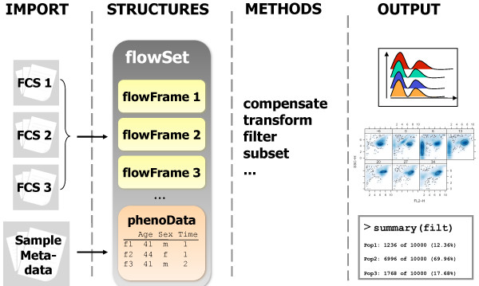
Flow Cytometry Data
Header: FCS standard and where to find other segments
Text: key-value pairs describing the file like datatype, parameters, etc.
Data: matrix like describing the events detected by the experiment
Analysis: optional segment contiaining results of downstream analysis
Hahne, F. et al. (2009) "flowCore: a Bioconductor package for high throughput flow cytometry", BMC Bioinformatics, 10(1). doi: 10.1186/1471-2105-10-106.
Drakos, J. et al. (2008) "A perspective for biomedical data integration: Design of databases for flow cytometry", BMC Bioinformatics, 9(1). doi: 10.1186/1471-2105-9-99.

Slide 9
Ways of Working with Flow Cytometry Data
Software for interactive analysis:
Benefits: ready to use with most functions already provided (compensation, interactive gating, transformation, etc.)
Disadvantage: less flexibility (what you see is what you get), manual analysis can be slower and less efficient
Computational approach:
Benefits: most above functionality is first implemented as open-source software if you can program in R or Python, more flexible, more scalable
Disadvantage: with great power comes great responsibility, takes time to learn and troubleshoot

Slide 10
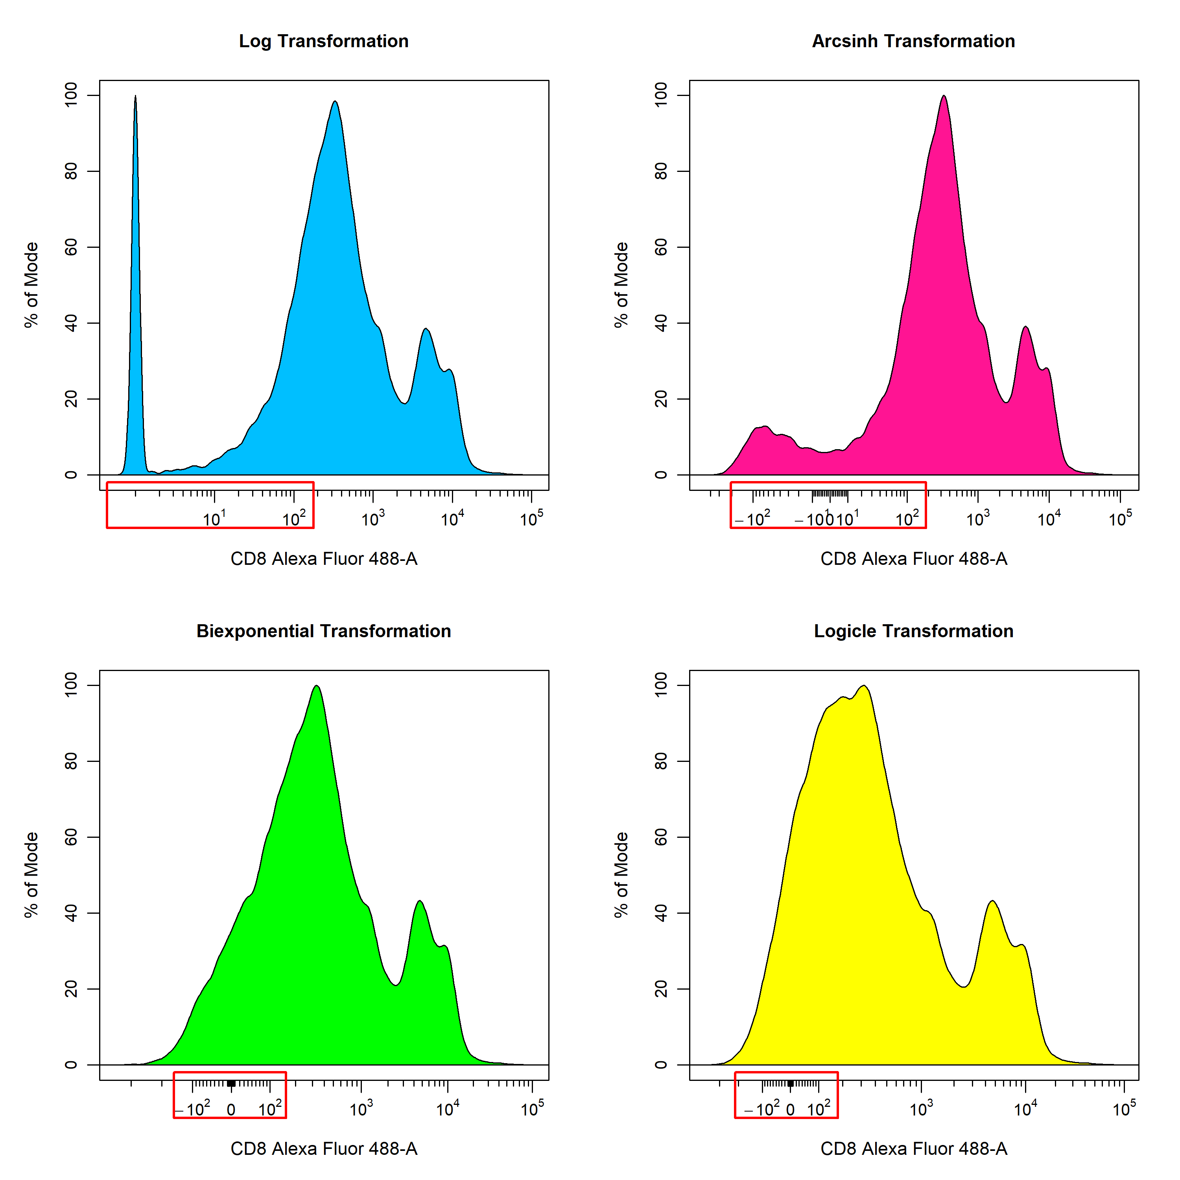
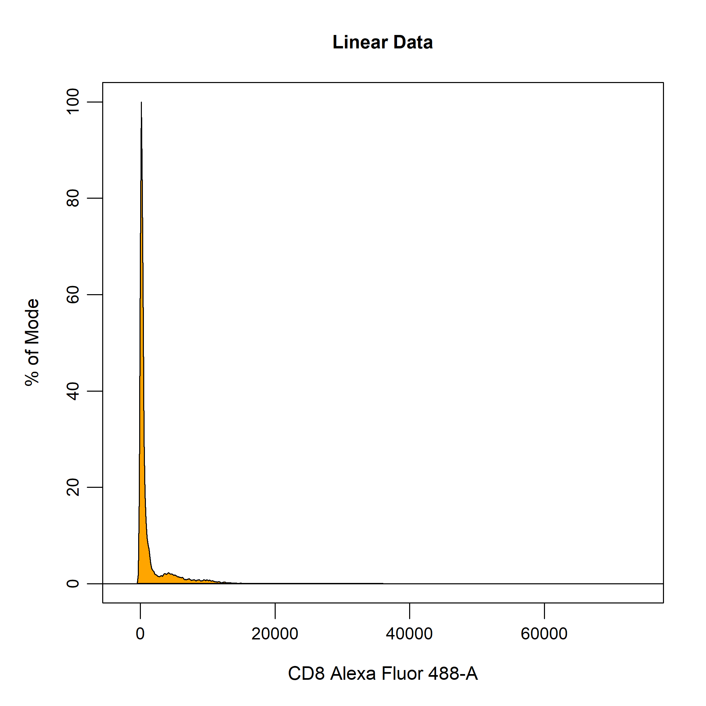
Data Preprocessing
Compensation
Transformation
Schmit, T., Klomp, M. and Khan, M. (2020) "An Overview of Flow Cytometry: Its Principles and Applications in Allergic Disease Research", Methods in Molecular Biology, pp. 169-182. doi: 10.1007/978-1-0716-1001-5_13.
Data Transformations (2021). Available at: https://dillonhammill.github.io/CytoExploreR/articles/CytoExploreR-Transformations.html (Accessed: 30 June 2023).

Slide 11
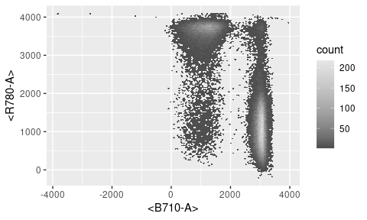
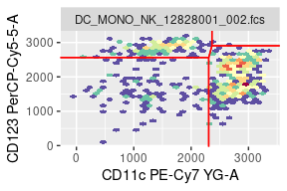
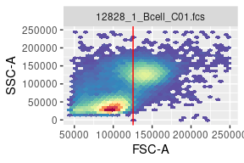
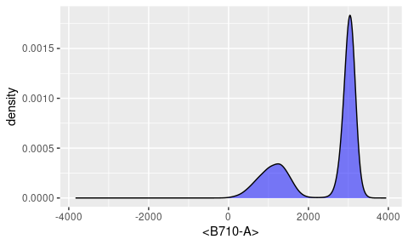
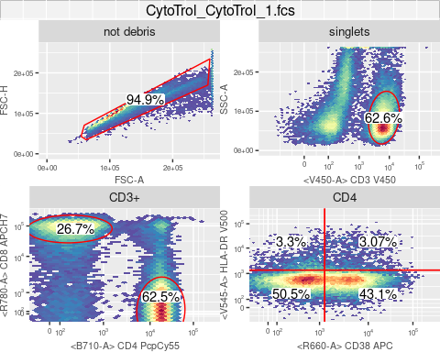
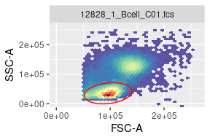
Data Visualization and Gating
Visualizations
Automated Gating
ggcyto : Visualize Cytometry data with ggplot (2023). Available at: https://www.bioconductor.org/packages/release/bioc/vignettes/ggcyto/inst/doc/Top_features_of_ggcyto.html (Accessed: 30 June 2023).
Jiang, M. (2023) OpenCyto: How to use different auto gating functions, Bioconductor.org. Available at: https://www.bioconductor.org/packages/devel/bioc/vignettes/openCyto/inst/doc/HowToAutoGating.html (Accessed: 30 June 2023).

Slide 12
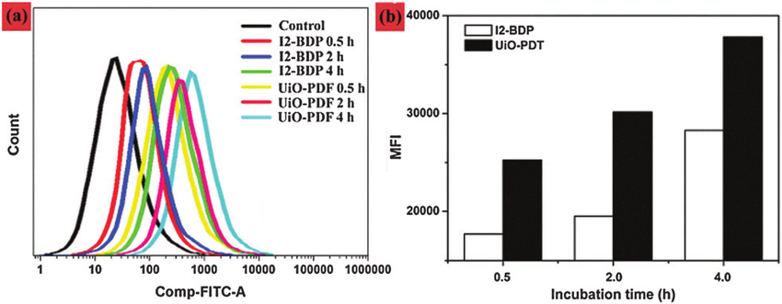
Basic Statistical Analysis
Population counts and percentiles
Mean Fluorescence Intensity (MFI)
Median Fluorescence Intensity
Wang, W. et al. (2016) "BODIPY-containing nanoscale metal–organic frameworks for photodynamic therapy", Chemical Communications, 52(31), pp. 5402-5405. doi: 10.1039/c6cc01048b.

Slide 13
Useful resources
flowCore: core analysis functions
https://bioconductor.org/packages/release/bioc/html/flowCore.html
ggcyto: visualization
https://www.bioconductor.org/packages/release/bioc/html/ggcyto.html
flowAI: data QC
https://www.bioconductor.org/packages/release/bioc/html/flowAI.html
openCyto: automated gating
https://bioconductor.org/packages/release/bioc/html/openCyto.html

Slide 14
Pre-requisites for tutorial
You will need to have R and RStudio installed, and the course materials downloaded from GitHub
R version 4.3.0+ (https://cran.r-project.org/)
Rstudio (https://www.rstudio.com/products/rstudio/)
Location of course materials: https://github.com/niaid/computational.flow.cytometry
If within NIAID, consider self-service for R and Rstudio install:
Windows self-service: https://inside.niaid.nih.gov/it-equipment/installing-scientific-software-using-software-center
Mac self-service: https://inside.niaid.nih.gov/it-equipment/installing-scientific-software-mac-self-service

Slide 15
Where to find R?
Within NIAID, you can use self-service or on the Skyline HPC cluster:
Windows Software Center: https://inside.niaid.nih.gov/it-equipment/installing-scientific-software-using-software-center
Mac self-service: https://inside.niaid.nih.gov/it-equipment/installing-scientific-software-mac-self-service
NIAID Skyline: https://skyline.niaid.nih.gov/
Within NIH, you can use the Biowulf HPC cluster: https://hpc.nih.gov/
Download and install R and Rstudio:
R: https://www.r-project.org/
Rstudio: https://www.rstudio.com/

Slide 16
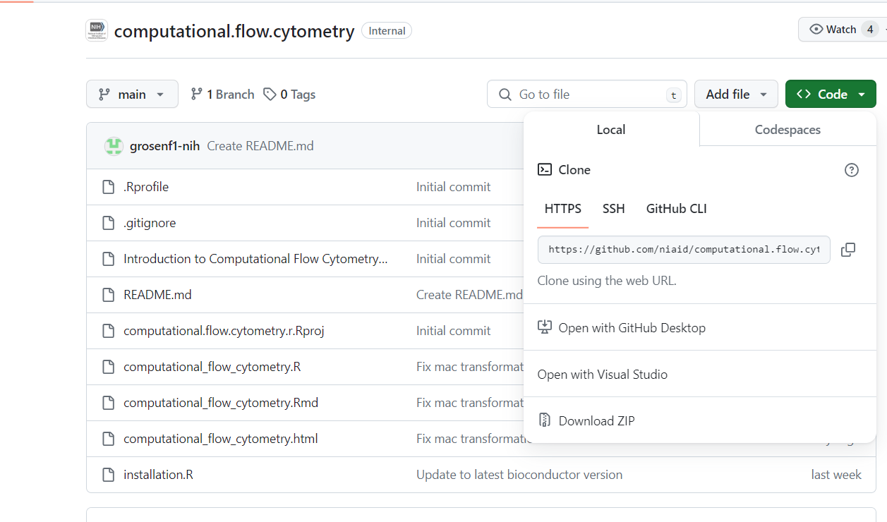
Tutorial Set Up
https://github.com/niaid/computational.flow.cytometry

Slide 17
Tutorial Set Up
Unzip the downloaded file in your downloads folder
Open the “computational_flow_cytometry.Rproj” file
If Rstudio is installed, then this should open the project in RStudio

Slide 18
Tutorial Set Up
While installing packages during tutorial, you will need to be off any VPN as this may interfere
In the Rstudio console (bottom left tab), add the following code below and then hit enter:
source(“installation.R”)
Open the “computational_flow_cytometry.R” file, which should pop up in the upper left quadrant of Rstudio
A “computational_flow_cytometry.html” file is also available to open in your browser if you would like to see the expected output at each step: it is generated from the corresponding .Rmd file

